Slide 1
NJ SLA, DLM and ACCESS: Spring 2019 Administrations Bridgeton Public Schools October 8, 2019
Measuring College and Career Readiness

Slide 2
NJ Student Learning Assessments: Spring 2019 Administration

Slide 3
Comparison of Bridgeton’s Spring 2017, Spring 2018 & Spring 2019 NJSLA Administrations English Language Arts - Percentages
Grade | Level 1 2017 | Level 1 2018 | Level 1 2019 | Level 2 2017 | Level 2 2018 | Level 2 2019 | Level 3 2017 | Level 3 2018 | Level 3 2019 | Level 4 2017 | Level 4 2018 | Level 4 2019 | Level 5 2017 | Level 5 2018 | Level 5 2019 | Change in Level 1 and 2 2017 to 2019 | Change in Level 4 and 5 2017 to 2019**
3 | 42 | 47 | 43 | 25 | 19 | 22 | 18 | 19 | 20 | 15 | 15 | 15 | 0 | 0 | 0 | -2 | 0
4 | 32 | 33 | 32 | 28 | 28 | 29 | 27 | 23 | 23 | 12 | 16 | 14 | 1 | 1 | 2 | 1 | 3
5 | 24 | 26 | 29 | 27 | 32 | 30 | 30 | 25 | 25 | 18 | 16 | 16 | 1 | 1 | 0 | 8 | -3
6 | 21 | 19 | 26 | 36 | 29 | 32 | 27 | 33 | 27 | 16 | 19 | 14 | 0 | 0 | 1 | 1 | -1
7 | 25 | 23 | 28 | 20 | 24 | 22 | 29 | 29 | 28 | 22 | 22 | 19 | 4 | 3 | 3 | 5 | -4
8 | 23 | 22 | 27 | 23 | 20 | 24 | 29 | 25 | 27 | 23 | 28 | 19 | 2 | 4 | 3 | 5 | -3
9 | 35 | 29 | 43 | 26 | 24 | 24 | 27 | 25 | 21 | 11 | 20 | 10 | 1 | 2 | 1 | 6 | -1
10 | 50 | 36 | 58 | 21 | 21 | 16 | 16 | 22 | 12 | 12 | 19 | 11 | 1 | 3 | 3 | 3 | 1
*Grade 11 test was optional for 2018-2019 assessment year. **Level 4 and Level 5 is an indication a student is on pace to be college and career ready.
Notes: Data shown is preliminary. Percentages may not total 100 due to rounding.

Slide 4
Comparison of Bridgeton’s Spring 2017, Spring 2018 & Spring 2019 NJSLA Administrations Mathematics - Percentages
Grade | Level 1 2017 | Level 1 2018 | Level 1 2019 | Level 2 2017 | Level 2 2018 | Level 2 2019 | Level 3 2017 | Level 3 2018 | Level 3 2019 | Level 4 2017 | Level 4 2018 | Level 4 2019 | Level 5 2017 | Level 5 2018 | Level 5 2019 | Change in Level 1 and 2 2017 to 2019 | Change in Level 4 and 5 2017 to 2019**
3 | 27 | 28 | 28 | 27 | 26 | 26 | 27 | 29 | 26 | 19 | 17 | 19 | 1 | 1 | 2 | 0 | 1
4 | 28 | 27 | 31 | 21 | 32 | 31 | 27 | 25 | 26 | 13 | 15 | 12 | 0 | 0 | 1 | 13 | 0
5 | 20 | 27 | 23 | 37 | 34 | 44 | 29 | 27 | 23 | 13 | 12 | 9 | 1 | 1 | 0 | 10 | -5
6 | 22 | 23 | 31 | 34 | 38 | 39 | 28 | 28 | 22 | 16 | 12 | 8 | 0 | 0 | 0 | 14 | -8
7 | 17 | 16 | 18 | 33 | 42 | 39 | 37 | 28 | 31 | 12 | 14 | 13 | 1 | 0 | 0 | 7 | 0
8* | 35 | 29 | 36 | 30 | 29 | 29 | 22 | 25 | 19 | 13 | 17 | 16 | 0 | 0 | 0 | 0 | 3
ALG I*** | 27 | 29 | 26 | 41 | 43 | 48 | 22 | 24 | 17 | 9 | 13 | 9 | 1 | 1 | 0 | 6 | -1
GEO*** | 26 | 20 | 32 | 55 | 50 | 51 | 17 | 21 | 16 | 3 | 9 | 1 | 0 | 0 | 0 | 2 | -2
ALG II*** | 63 | 52 | 54 | 21 | 32 | 19 | 11 | 10 | 21 | 4 | 6 | 7 | 0 | 0 | 0 | -11 | 3
*Approximately 30,000 New Jersey students in grade 8 participated in the Algebra I assessment. Thus, Math 8 outcomes are not representative of grade 8 performance as a whole. **Level 4 and Level 5 is an indication a student is on pace to be college and career ready.
*** NJSLA 2018-2019 assessments were optional for 11th Grade students
Notes: Data shown is preliminary. Percentages may not total 100 due to rounding. ALG 1 Is Algebra 1; GEO is Geometry; ALG II is Algebra 2.

Slide 5
Comparison of Bridgeton’s 2017 to 2019 Spring NJSLA Administrations English Language Arts – Percentage Changes
Grade | Levels 1 & 2 District Trend | Levels 1 & 2 District | Levels 1 & 2 State Trend | Levels 1 & 2 State | Level 3 District Trend | Level 3 District | Level 3 State Trend | Level 3 State | Levels 4 & 5 District Trend | Levels 4 & 5 District | Levels 4 & 5 State Trend | Levels 4 & 5 State
3 | − | -2 | + | 1.3 | + | 2 | − | 1.1 | NA | 0 | − | 0.1
4 | + | 1 | + | 0.7 | − | -4 | − | 2.3 | + | 3 | + | 1.5
5 | + | 8 | + | 0.9 | − | -5 | + | 0.1 | − | -3 | − | 1.1
6 | + | 1 | − | 1.1 | NA | 0 | − | 1.7 | − | -1 | + | 2.8
7 | + | 5 | − | 1.0 | − | -1 | − | 2.7 | − | -4 | + | 3.6
8 | + | 5 | − | 1.2 | − | -2 | − | 2.6 | − | -3 | + | 3.7
9 | + | 6 | − | 2.5 | − | -6 | − | 1.8 | − | -1 | + | 4.4
10 | + | 3 | − | 8.9 | − | -4 | − | 3.6 | + | 1 | + | 12.5
* NJSLA 2018-2019 assessments were optional for 11th Grade students . State Percentages do not include results for Grade 11.
Notes: Percentages may not total 100 due to rounding.
The plus sign (+) indicates an increase of the % change from the previous year where a minus sign (-) shows a decrease of the % change from the previous year.

Slide 6
Comparison of Bridgeton’s 2017 to 2019 Spring NJSLA Administrations Mathematics – Percentage Changes
Grade | Levels 1 & 2 District Trend | Levels 1 & 2 District | Levels 1 & 2 State Trend | Levels 1 & 2 State | Level 3 District Trend | Level 3 District | Level 3 State Trend | Level 3 State | Levels 4 & 5 District Trend | Levels 4 & 5 District | Levels 4 & 5 State Trend | Levels 4 & 5 State
3 | NA | 0 | − | 0.5% | − | -1 | − | 2.1% | + | 1 | + | 2.6%
4 | + | 13 | − | 2.3% | − | -1 | − | 1.4% | NA | 0 | + | 3.7%
5 | + | 10 | + | 3.2% | − | -6 | − | 3.8% | − | -5 | + | 0.6%
6 | + | 14 | + | 3.4% | − | -6 | − | 0.3% | − | -8 | − | 3.1%
7 | + | 7 | + | 0.7% | − | -6 | − | 3.7% | NA | 0 | + | 1.6%
8 | NA | 0 | + | 2.1% | − | -3 | − | 0.4% | + | 3 | + | 2.6%
Algebra I*** | + | 6 | + | 2.0% | − | -5 | − | 3.0% | − | -1 | + | 1.0%
Algebra II*** | + | 2 | − | 1.1% | − | -1 | NA | 0.0% | − | -2 | + | 1.1%
Geometry*** | − | -11 | − | 0.1% | + | 10 | + | 0.3% | + | 3 | − | 0.3%
*Some students in grade 8 participated in the Algebra I assessment in place of the 8th grade Math assessment. Thus, Math 8 outcomes are not representative of grade 8 performance as a whole. *** NJSLA 2018-2019 assessments were optional for 11th Grade students, state results do not include Grade 11 results.
Notes: Percentages may not total 100 due to rounding.
- The plus sign (+) indicates an increase of the % change from the previous year where a minus sign (-) shows a decrease of the % change from the previous year.

Slide 7
Comparison of Bridgeton’s Number of Students Tested Spring 2018 & Spring 2019 NJSLA Administrations English Language Arts
Grade | Students Tested 2019 | Students Tested 2018 | Difference between number of students tested in 2018 and 2019
3 | 468 | 473 | -5
4 | 486 | 490 | -4
5 | 493 | 484 | 9
6 | 479 | 475 | 4
7 | 474 | 445 | 29
8 | 445 | 393 | 52
9 | 292 | 342 | -50
10 | 274 | 339 | -65
Total | 3411 | 3441 | -30
** NJSLA 2018-2019 assessments were optional for 11th Grade students.
Note: “Students Tested” represents individual valid test scores for English Language Arts.

Slide 8
Comparison of Bridgeton’s Number of Students Tested Spring 2018 & Spring 2019 NJSLA Administrations Mathematics
Grade | Students Tested 2019 | Students Tested 2018 | Difference between number of students tested in 2018 and 2019
3 | 479 | 478 | 1
4 | 491 | 496 | -5
5 | 498 | 489 | 9
6 | 487 | 478 | 9
7 | 486 | 451 | 35
8* | 432 | 381 | 51
Algebra I** | 321 | 355 | -34
Algebra II** | 43 | 301 | -258
Geometry** | 252 | 318 | -66
Total | 3489 | 3747 | -258
*Some students in grade 8 participated in the Algebra I assessment in place of the 8th grade Math assessment. Thus, Math 8 outcomes are not representative of grade 8 performance as a whole.
** NJSLA 2018-2019 assessments were optional for 11th Grade students
Notes: “Students Tested” represents individual valid test scores for Mathematics.

Slide 9
Comparison of Bridgeton’s Spring 2019 NJSLA Administrations English Language Arts to New Jersey Percentages for 2019
Grade | Level 1, District | Level 1, State | Level 2, District | Level 2, State | Level 3, District | Level 3, State | Level 4, District | Level 4, State | Level 5, District | Level 5, State
3 | 42.9 | 14.0 | 22.2 | 14.4 | 19.7 | 21.4 | 14.7 | 42.8 | 0.4 | 7.4
4 | 32.1 | 8.6 | 29.4 | 12.6 | 23.0 | 21.4 | 13.8 | 39.1 | 1.6 | 18.3
5 | 28.6 | 7.4 | 29.8 | 12.5 | 25.2 | 22.2 | 16.2 | 45.6 | 0.2 | 12.3
6 | 25.9 | 7.3 | 32.2 | 12.6 | 27.3 | 23.9 | 13.8 | 40.9 | 0.8 | 15.2
7 | 27.6 | 8.9 | 22.2 | 10.5 | 28.1 | 17.8 | 19.0 | 33.1 | 3.2 | 29.7
8 | 27.2 | 9.2 | 24.0 | 10.3 | 27.2 | 17.7 | 18.9 | 38.0 | 2.7 | 24.9
9 | 42.8 | 11.3 | 24.3 | 11.8 | 21.2 | 21.1 | 10.3 | 36.7 | 1.4 | 19.2
10 | 58.0 | 14.3 | 15.7 | 10.9 | 12.4 | 15.9 | 11.3 | 33.4 | 2.6 | 25.5
*Grade 11 does not include students who took an AP/IB test.
** NJSLA 2018-2019 assessments were optional for 11th Grade students, state results do not include Grade 11 results.
Notes: Percentages may not total 100 due to rounding.

Slide 10
Comparison of Bridgeton’s Spring 2019 NJSLA Administrations Mathematics to New Jersey - Percentages for 2019
Grade | Level 1, District | Level 1, State | Level 2, District | Level 2, State | Level 3, District | Level 3, State | Level 4, District | Level 4, State | Level 5, District | Level 5, State
3 | 27.6 | 8.0 | 25.7 | 13.9 | 25.9 | 23.0 | 19.4 | 41.2 | 1.5 | 13.9
4 | 30.5 | 8.6 | 31.0 | 14.7 | 25.5 | 25.7 | 12.2 | 43.3 | 0.8 | 7.7
5 | 22.9 | 6.4 | 44.4 | 20.9 | 23.3 | 25.8 | 9.2 | 35.8 | 0.2 | 11.0
6 | 31.0 | 9.6 | 38.6 | 22.5 | 22.0 | 27.4 | 8.2 | 33.1 | 0.2 | 7.5
7 | 17.5 | 7.6 | 39.1 | 21.1 | 30.7 | 29.3 | 12.6 | 33.8 | 0.2 | 8.3
8* | 35.6 | 23.3 | 28.7 | 23.1 | 19.2 | 24.3 | 16.2 | 28.2 | 0.2 | 1.1
Algebra I** | 26.2 | 9.3 | 47.7 | 26.0 | 17.1 | 21.4 | 9.0 | 37.7 | 0.0 | 5.6
Algebra II** | 53.5 | 10.6 | 18.6 | 11.7 | 20.9 | 21.4 | 7.0 | 49.7 | 0.0 | 6.6
Geometry** | 31.7 | 10.4 | 50.8 | 24.6 | 16.3 | 32.8 | 1.2 | 26.9 | 0.0 | 5.3
*Some students in grade 8 participated in the Algebra I assessment in place of the 8th grade Math assessment. Thus, Math 8 outcomes are not representative of grade 8 performance as a whole.
** NJSLA 2018-2019 assessments were optional for 11th Grade students, state results do not include Grade 11 results.
Notes: Percentages may not total 100 due to rounding.

Slide 11
Bridgeton’s 2019 Spring NJSLA School- & Grade-Level Outcomes English Language Arts Grade 3 - Percentages
ELA03 | Not Yet Meeting Expectations (Level 1) | Partially Meeting Expectations (Level 2) | Approaching Expectations (Level 3) | Meeting Expectations (Level 4) | Exceeding Expectations (Level 5) | % of students at Level 4 and 5
Broad | 59 | 24 | 15 | 3 | 0 | 3
Buck | 27 | 28 | 22 | 22 | 2 | 24
Cherry | 34 | 25 | 24 | 18 | 0 | 18
Indian | 37 | 10 | 26 | 28 | 0 | 28
QML | 53 | 18 | 17 | 13 | 0 | 13
West | 33 | 33 | 20 | 13 | 2 | 15

Slide 12
Bridgeton’s 2019 Spring NJSLA School- & Grade-Level Outcomes English Language Arts Grade 4 - Percentages
ELA04 | Not Yet Meeting Expectations (% Level 1) | Partially Meeting Expectations (% Level 2) | Approaching Expectations (% Level 3) | Meeting Expectations (% Level 4) | Exceeding Expectations (% Level 5) | % of students at Level 4 and 5
Broad | 36 | 28 | 22 | 13 | 1 | 14
Buck | 23 | 41 | 27 | 8 | 2 | 10
Cherry | 34 | 27 | 33 | 6 | 0 | 6
Indian | 11 | 31 | 31 | 20 | 7 | 27
QML | 50 | 27 | 11 | 12 | 1 | 13
West | 27 | 26 | 23 | 24 | 0 | 24

Slide 13
Bridgeton’s 2019 Spring NJSLA School- & Grade-Level Outcomes English Language Arts Grade 5 - Percentages
ELA05 | Not Yet Meeting Expectations (% Level 1) | Partially Meeting Expectations (% Level 2) | Approaching Expectations (% Level 3) | Meeting Expectations (% Level 4) | Exceeding Expectations (% Level 5) | % of students at Level 4 and 5
Broad | 28 | 27 | 26 | 18 | 1 | 19
Buck | 28 | 29 | 27 | 16 | 0 | 16
Cherry | 36 | 30 | 23 | 10 | 0 | 10
Indian | 22 | 33 | 23 | 22 | 0 | 22
QML | 26 | 32 | 27 | 14 | 0 | 14
West | 33 | 28 | 24 | 15 | 0 | 15

Slide 14
Bridgeton’s 2019 Spring NJSLA School- & Grade-Level Outcomes English Language Arts Grade 6 - Percentages
ELA06 | Not Yet Meeting Expectations (% Level 1) | Partially Meeting Expectations (% Level 2) | Approaching Expectations (% Level 3) | Meeting Expectations (% Level 4) | Exceeding Expectations (% Level 5) | % of students at Level 4 and 5
Broad | 30 | 24 | 30 | 14 | 2 | 16
Buck | 33 | 39 | 12 | 15 | 2 | 17
Cherry | 28 | 41 | 22 | 9 | 0 | 9
Indian | 30 | 36 | 28 | 6 | 0 | 6
QML | 19 | 32 | 32 | 16 | 1 | 17
West | 15 | 35 | 32 | 17 | 1 | 18

Slide 15
Bridgeton’s 2019 Spring NJSLA School- & Grade-Level Outcomes English Language Arts Grade 7 - Percentages
ELA07 | Not Yet Meeting Expectations (% Level 1) | Partially Meeting Expectations (% Level 2) | Approaching Expectations (% Level 3) | Meeting Expectations (% Level 4) | Exceeding Expectations (% Level 5) | % of students at Level 4 and 5
Broad | 34 | 24 | 25 | 14 | 4 | 18
Buck | 25 | 27 | 34 | 14 | 0 | 14
Cherry | 37 | 24 | 23 | 16 | 0 | 16
Indian | 25 | 18 | 36 | 18 | 4 | 22
QML | 32 | 20 | 25 | 22 | 0 | 22
West | 14 | 35 | 28 | 22 | 1 | 23

Slide 16
Bridgeton’s 2019 Spring NJSLA School- & Grade-Level Outcomes English Language Arts Grade 8 - Percentages
ELA08 | Not Yet Meeting Expectations (% Level 1) | Partially Meeting Expectations (% Level 2) | Approaching Expectations (% Level 3) | Meeting Expectations (% Level 4) | Exceeding Expectations (% Level 5) | % of students at Level 4 and 5
Broad | 37 | 22 | 19 | 21 | 2 | 23
Buck | 16 | 22 | 40 | 22 | 0 | 22
Cherry | 38 | 27 | 24 | 11 | 0 | 11
Indian | 28 | 21 | 31 | 21 | 0 | 21
QML | 22 | 33 | 33 | 11 | 0 | 11
West | 15 | 20 | 40 | 20 | 5 | 25

Slide 17
Bridgeton’s 2019 Spring NJSLA School- & Grade-Level Outcomes Mathematics Grade 3 - Percentages
MAT03 | Not Yet Meeting Expectations (Level 1) | Partially Meeting Expectations (Level 2) | Approaching Expectations (Level 3) | Meeting Expectations (Level 4) | Exceeding Expectations (Level 5) | % of students at Level 4 and 5
Broad | 42 | 34 | 18 | 6 | 0 | 6
Buck | 20 | 27 | 33 | 18 | 2 | 20
Cherry | 24 | 27 | 27 | 24 | 0 | 24
Indian | 12 | 14 | 33 | 36 | 5 | 41
QML | 34 | 23 | 23 | 19 | 1 | 20
West | 21 | 25 | 30 | 23 | 2 | 25

Slide 18
Bridgeton’s 2019 Spring NJSLA School- & Grade-Level Outcomes Mathematics Grade 4 - Percentages
MAT04 | Not Yet Meeting Expectations (Level 1) | Partially Meeting Expectations (Level 2) | Approaching Expectations (Level 3) | Meeting Expectations (Level 4) | Exceeding Expectations (Level 5) | % of students at Level 4 and 5
Broad | 26 | 38 | 26 | 9 | 0 | 9
Buck | 22 | 34 | 31 | 12 | 2 | 14
Cherry | 26 | 35 | 28 | 9 | 2 | 11
Indian | 21 | 25 | 32 | 22 | 0 | 22
QML | 54 | 28 | 11 | 7 | 0 | 7
West | 24 | 23 | 32 | 18 | 3 | 21

Slide 19
Bridgeton’s 2019 Spring NJSLA School- & Grade-Level Outcomes Mathematics Grade 5 - Percentages
MAT05 | Not Yet Meeting Expectations (Level 1) | Partially Meeting Expectations (Level 2) | Approaching Expectations (Level 3) | Meeting Expectations (Level 4) | Exceeding Expectations (Level 5) | % of students at Level 4 and 5
Broad | 23 | 40 | 24 | 14 | 0 | 14
Buck | 22 | 43 | 27 | 7 | 2 | 9
Cherry | 19 | 44 | 30 | 7 | 0 | 7
Indian | 20 | 47 | 25 | 8 | 0 | 8
QML | 29 | 50 | 17 | 5 | 0 | 5
West | 25 | 44 | 19 | 12 | 0 | 12

Slide 20
Bridgeton’s 2019 Spring NJSLA School- & Grade-Level Outcomes Mathematics Grade 6 - Percentages
MAT06 | Not Yet Meeting Expectations (Level 1) | Partially Meeting Expectations (Level 2) | Approaching Expectations (Level 3) | Meeting Expectations (Level 4) | Exceeding Expectations (Level 5) | % of students at Level 4 and 5
Broad | 34 | 44 | 18 | 5 | 0 | 5
Buck | 39 | 36 | 13 | 12 | 0 | 12
Cherry | 25 | 43 | 28 | 3 | 2 | 5
Indian | 45 | 35 | 17 | 3 | 0 | 3
QML | 36 | 38 | 20 | 6 | 0 | 6
West | 31 | 29 | 30 | 10 | 0 | 10

Slide 21
Bridgeton’s 2019 Spring NJSLA School- & Grade-Level Outcomes Mathematics Grade 7 - Percentages
MAT07 | Not Yet Meeting Expectations (Level 1) | Partially Meeting Expectations (Level 2) | Approaching Expectations (Level 3) | Meeting Expectations (Level 4) | Exceeding Expectations (Level 5) | % of students at Level 4 and 5
Broad | 25 | 39 | 28 | 8 | 0 | 8
Buck | 14 | 37 | 41 | 9 | 0 | 9
Cherry | 11 | 50 | 25 | 14 | 0 | 14
Indian | 20 | 41 | 29 | 9 | 1 | 10
QML | 15 | 39 | 34 | 12 | 0 | 12
West | 14 | 38 | 34 | 14 | 0 | 14

Slide 22
Bridgeton’s 2019 Spring NJSLA School- & Grade-Level Outcomes Mathematics Grade 8 - Percentages
MAT08 | Not Yet Meeting Expectations (Level 1) | Partially Meeting Expectations (Level 2) | Approaching Expectations (Level 3) | Meeting Expectations (Level 4) | Exceeding Expectations (Level 5) | % of students at Level 4 and 5
Broad | 50 | 21 | 17 | 12 | 0 | 12
Buck | 22 | 40 | 22 | 16 | 0 | 16
Cherry | 39 | 25 | 21 | 15 | 0 | 15
Indian | 38 | 27 | 17 | 17 | 0 | 17
QML | 28 | 33 | 24 | 15 | 0 | 15
West | 32 | 29 | 23 | 16 | 0 | 16

Slide 23
Dynamic Learning Maps: Spring 2019 Administration

Slide 24
Bridgeton’s 2018 Spring DLM District- & Grade-Level Outcomes

Slide 25
Bridgeton’s 2019 Spring DLM School- & Grade-Level Outcomes

Slide 26
ACCESS for ELLs: Spring 2019 Administration

Slide 27
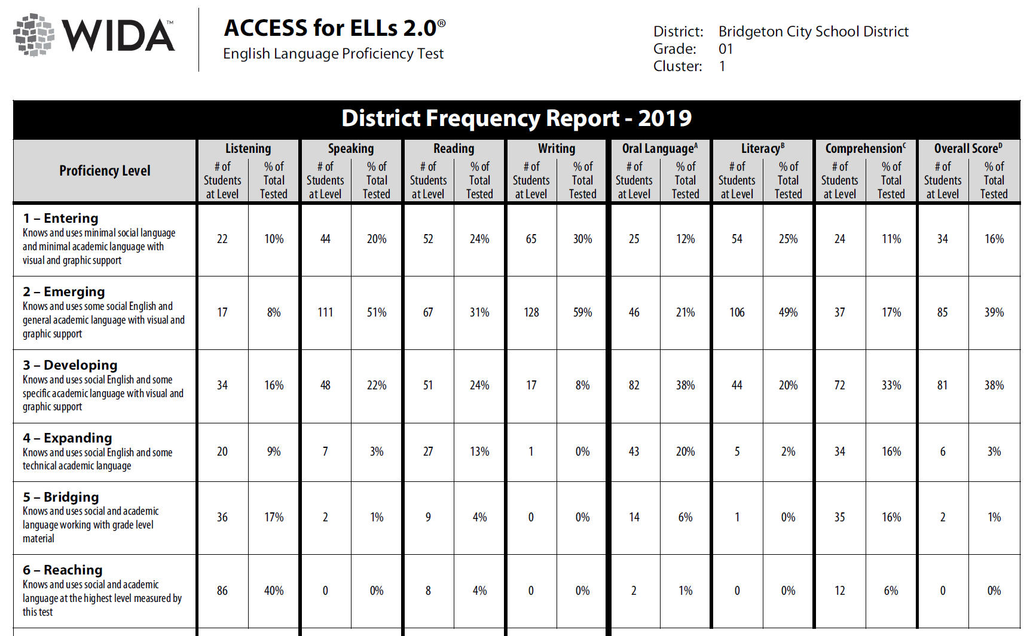

Slide 28
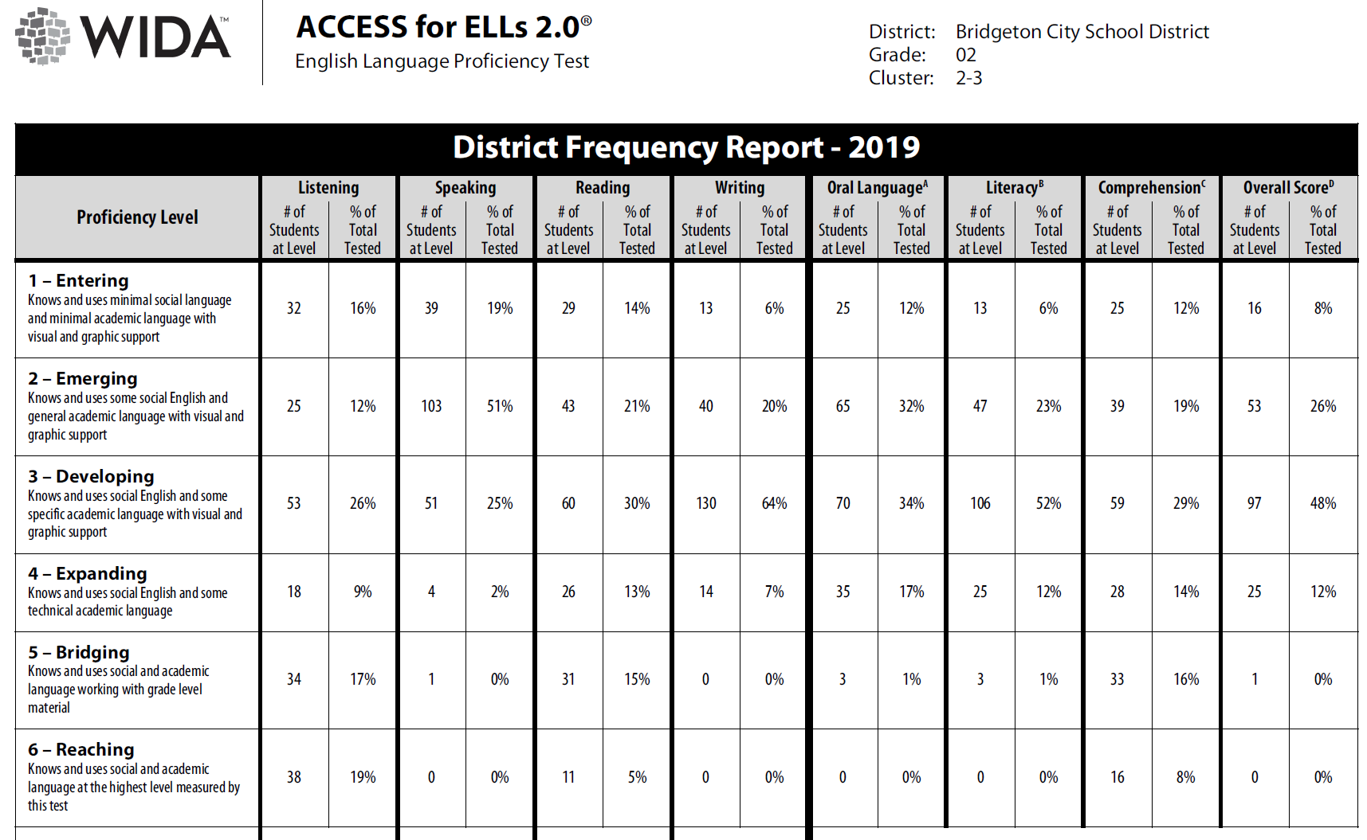

Slide 29
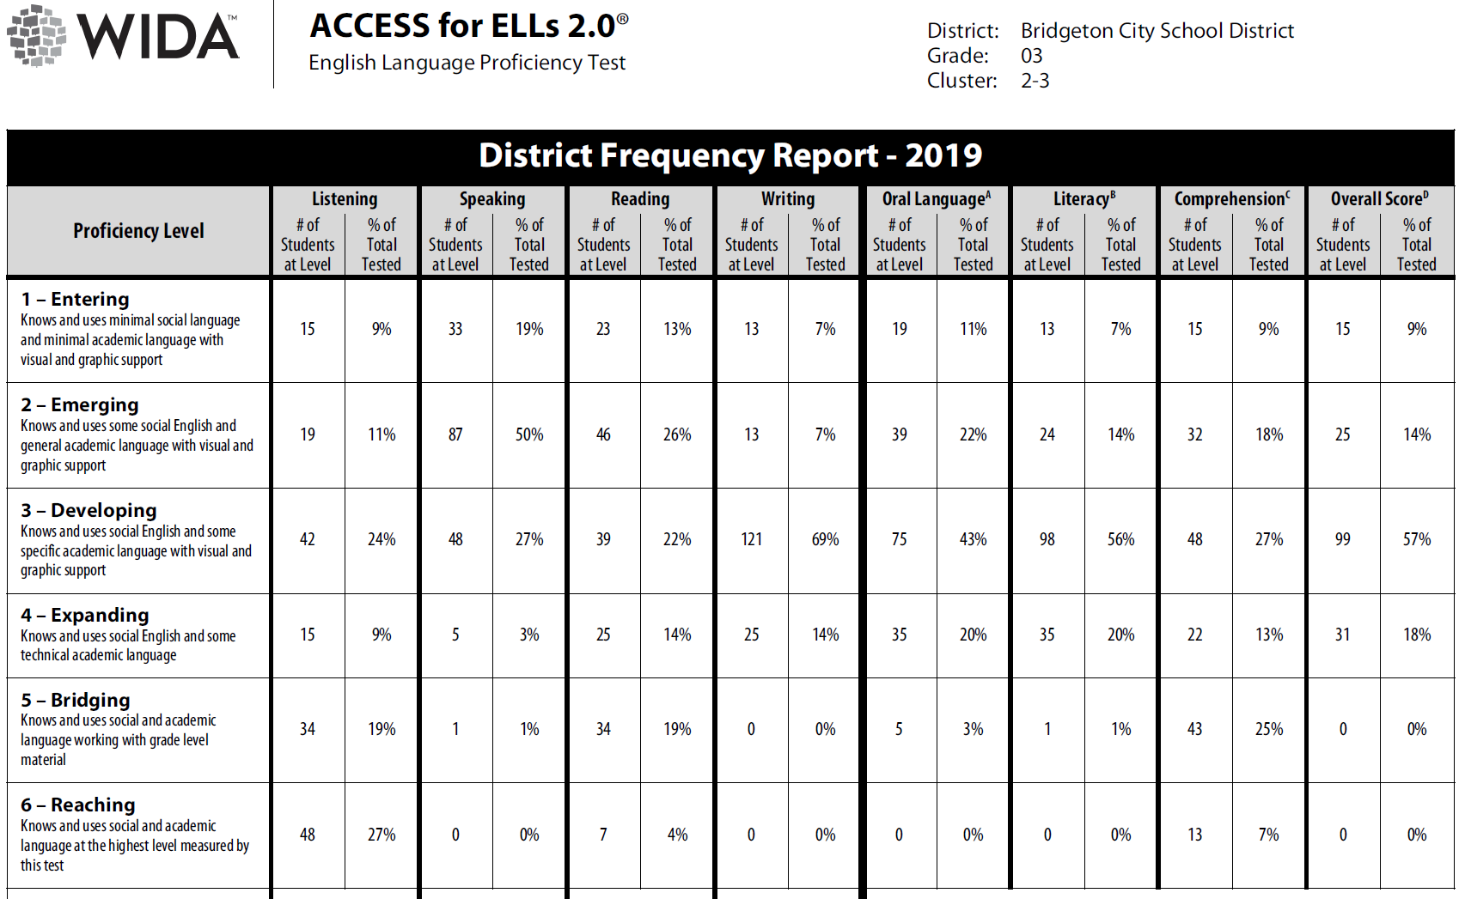

Slide 30
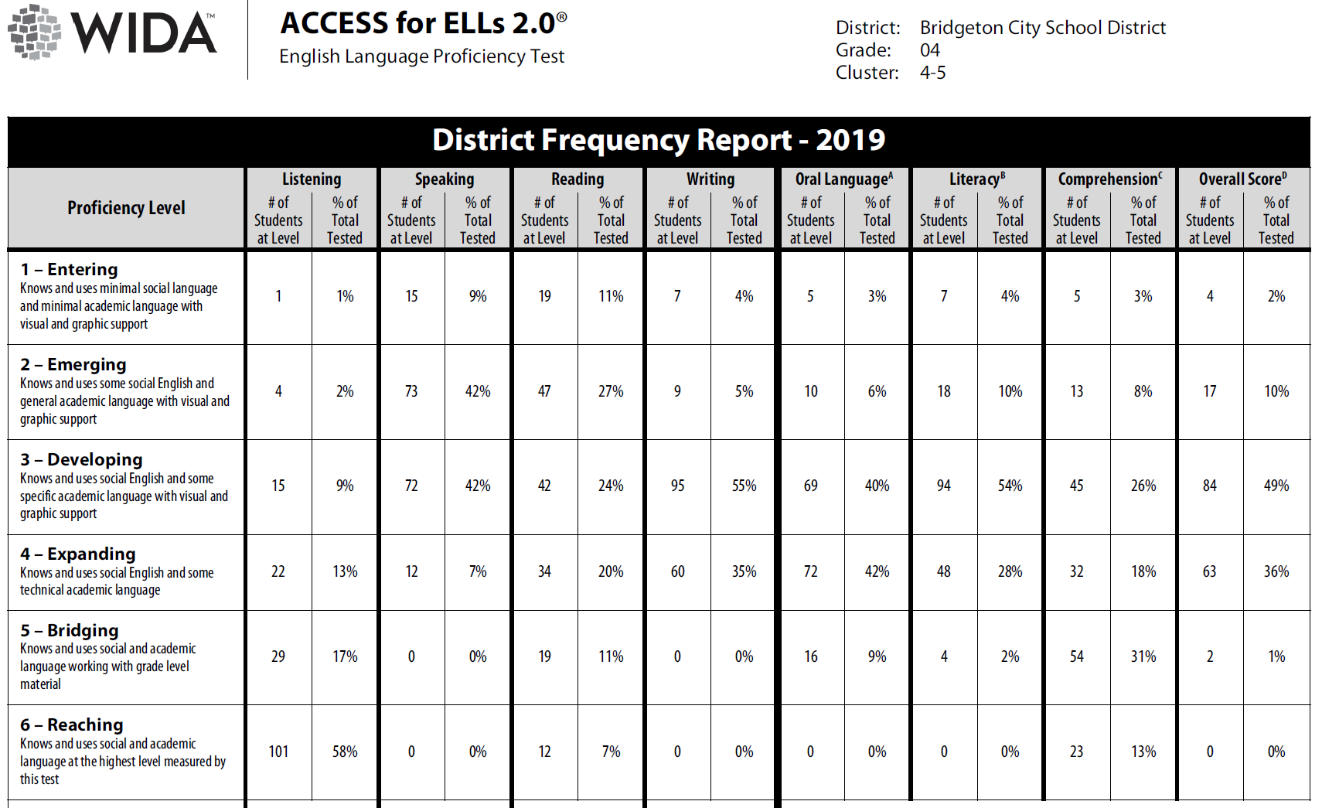

Slide 32
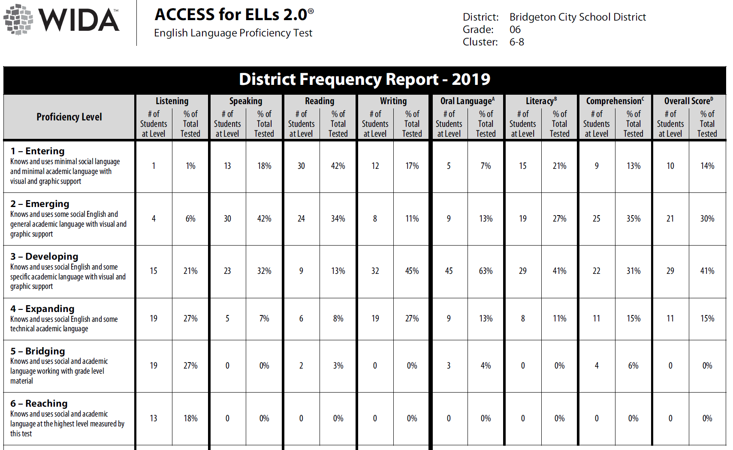

Slide 35
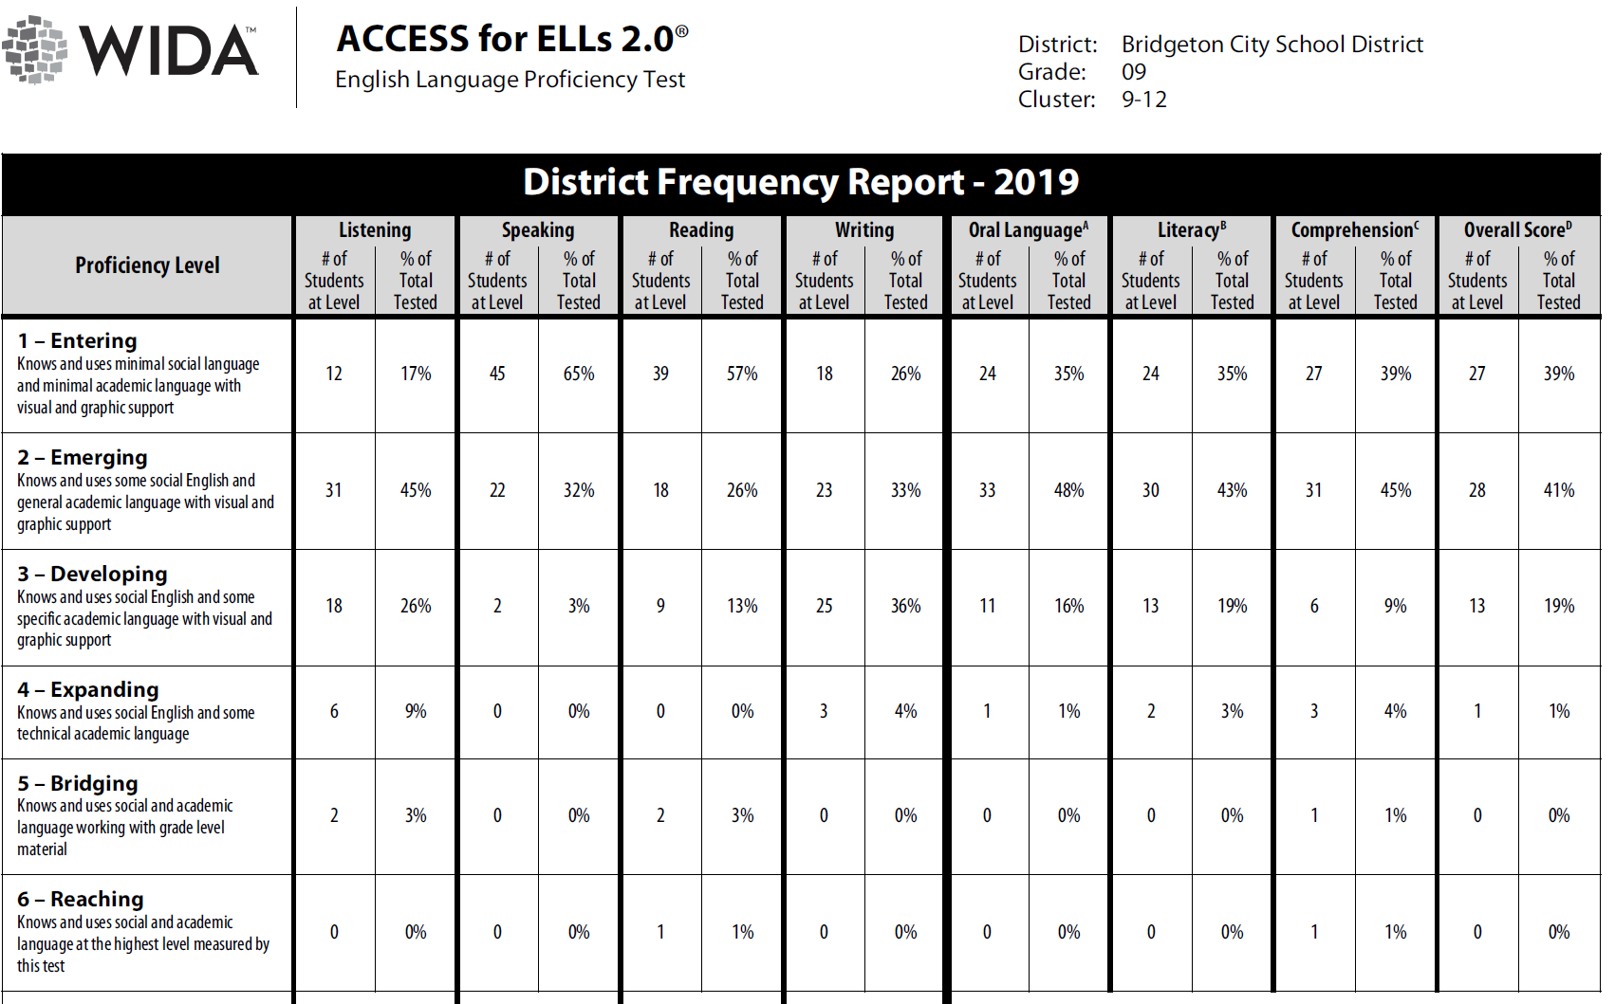

Slide 36
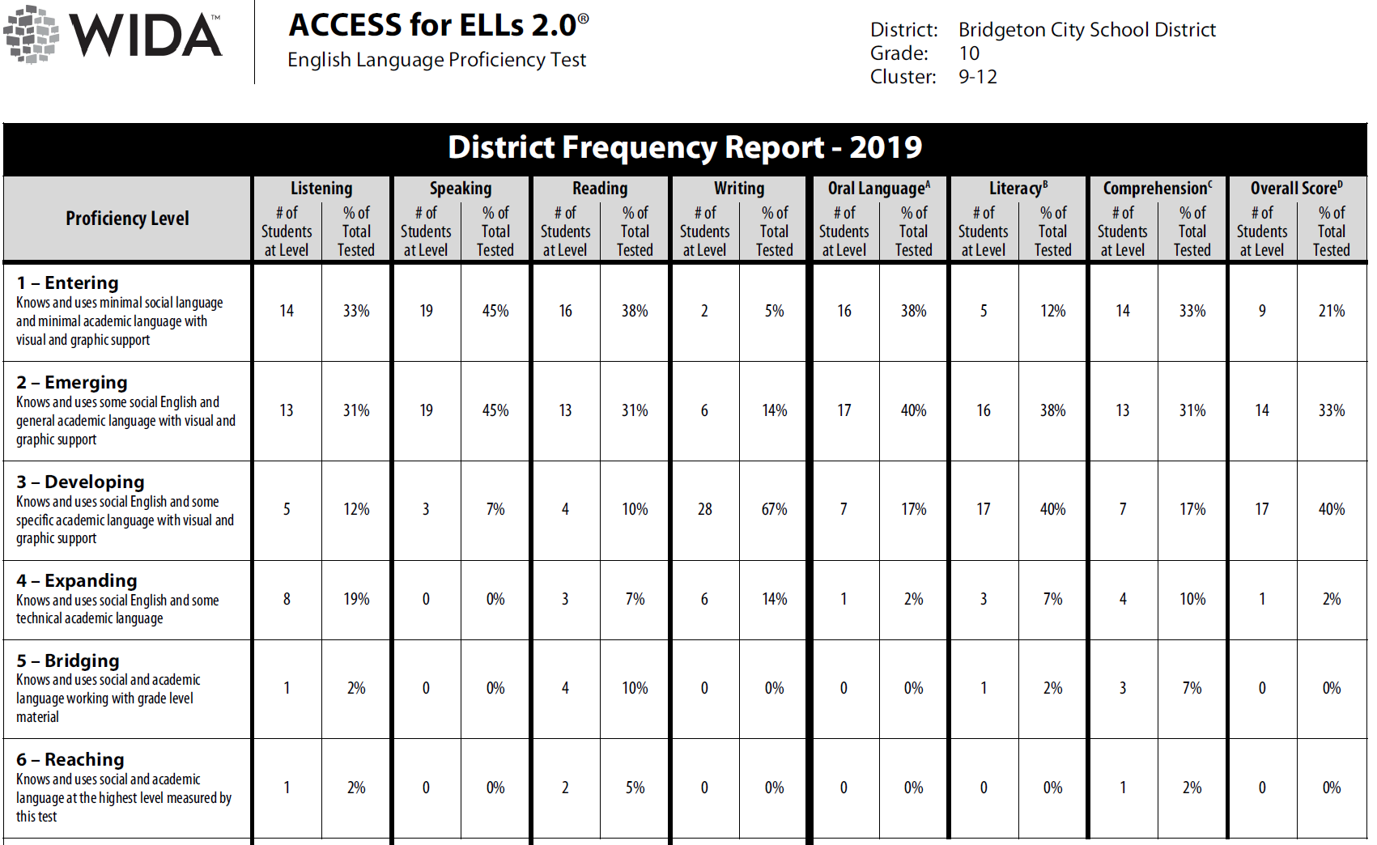

Slide 37
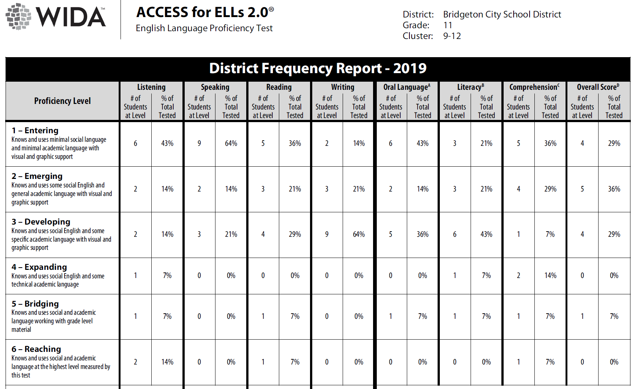

Slide 38
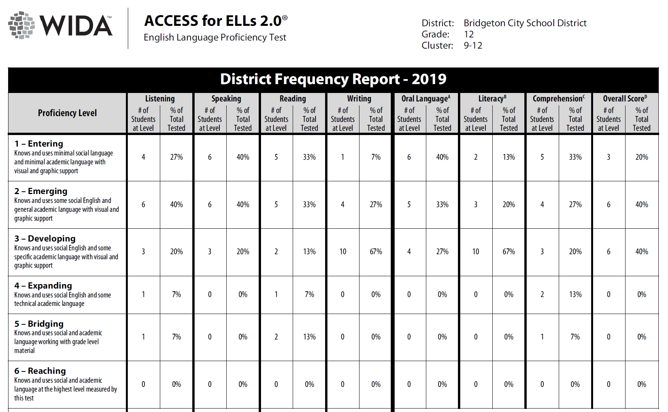

Slide 39
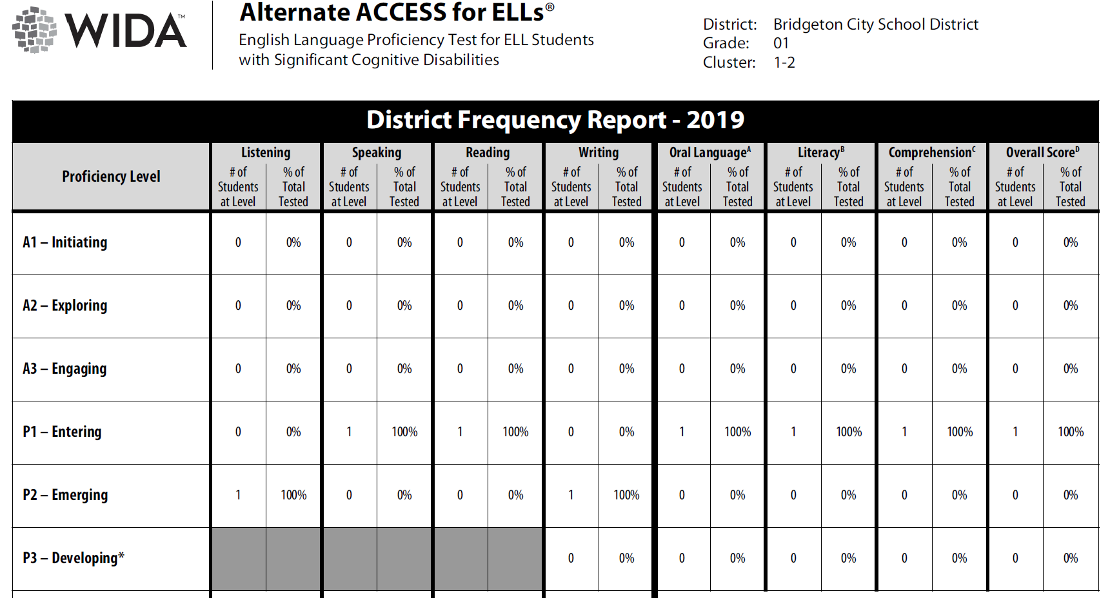

Slide 41
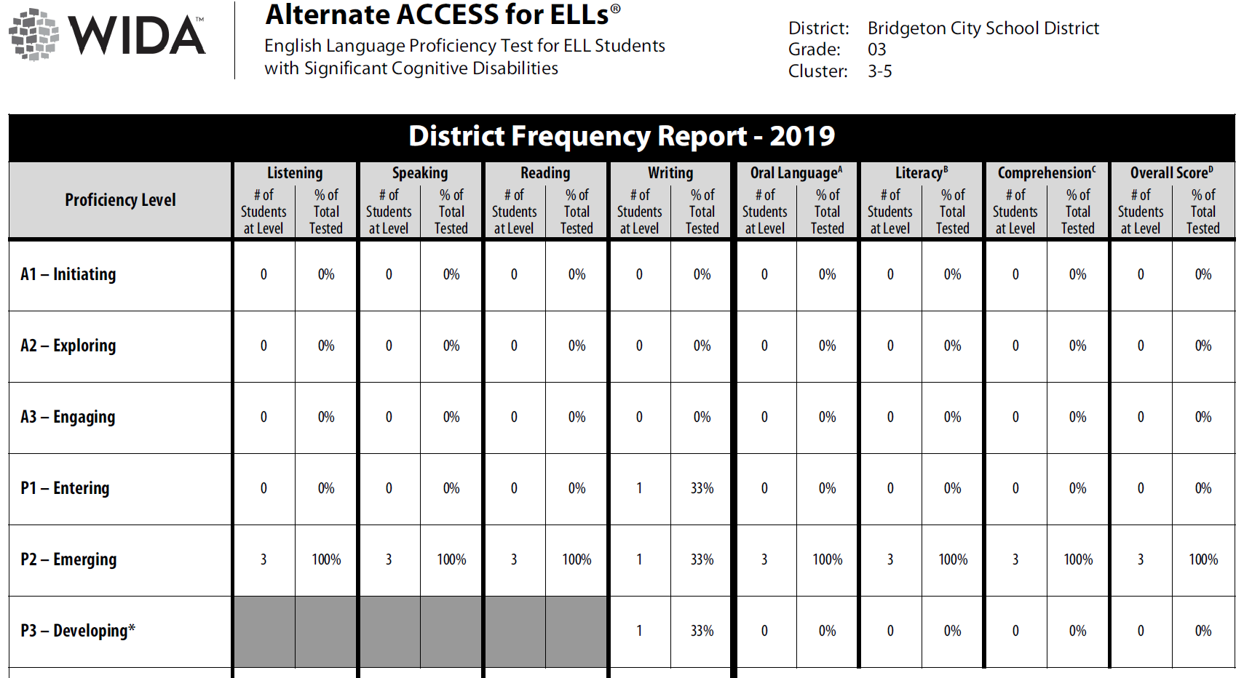

Slide 42
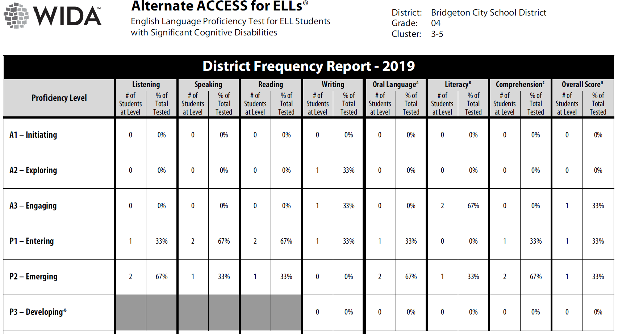

Slide 43
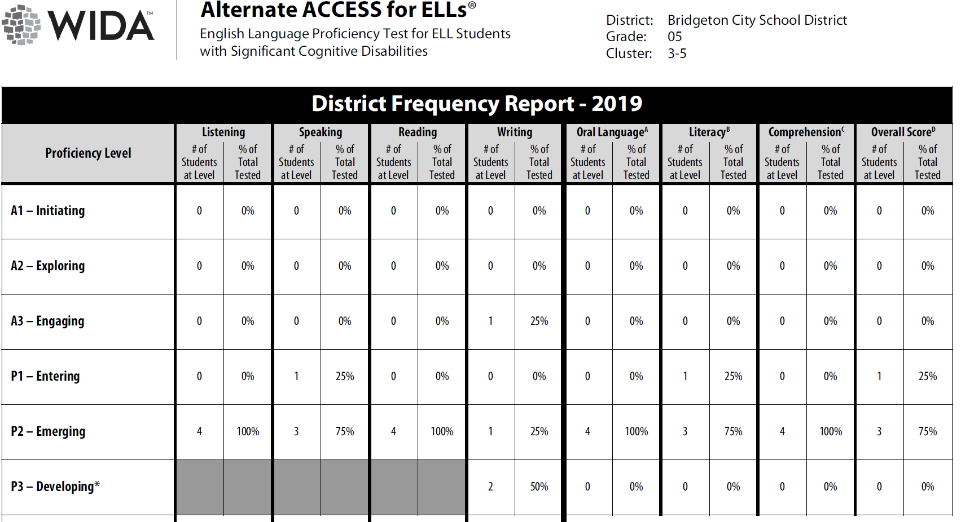

Slide 44
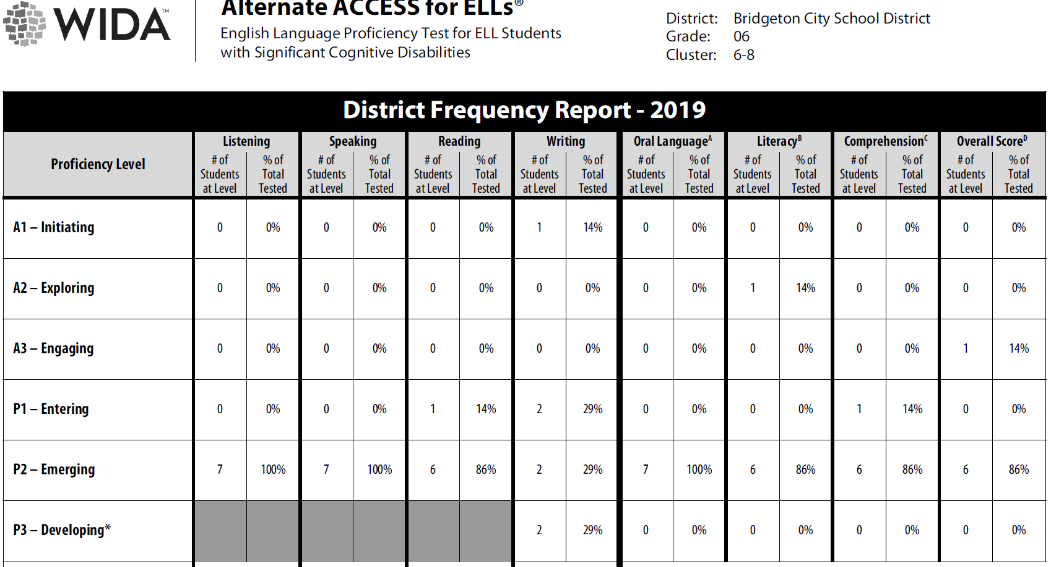

Slide 46
